Slide 1

Search in COMP
COMP1011 Group 8
Yunfei LIU, Jiaming HAN, Longling GENG, Zhuchen WANG

Slide 2
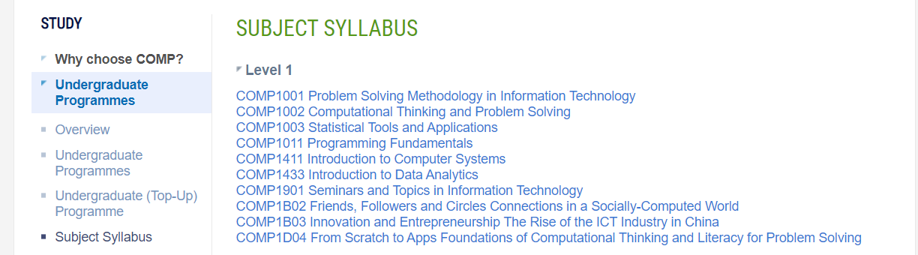
Introduction
A search engine to search information on COMP subjects

Slide 3
Introduction
Fulfill project requirements
Have more advanced features
Search in all content
User interaction for detail
Description form download

Slide 4
User Instructions
A user-friendly program.
1. Type keywords
2. View the result
3. Select and view details

Slide 5

Algorithm
Speed is the most important
We refer to the algorithm of Elastic Search
We improved the search method for our needs
We use “reverse index” for sorting.

Slide 6
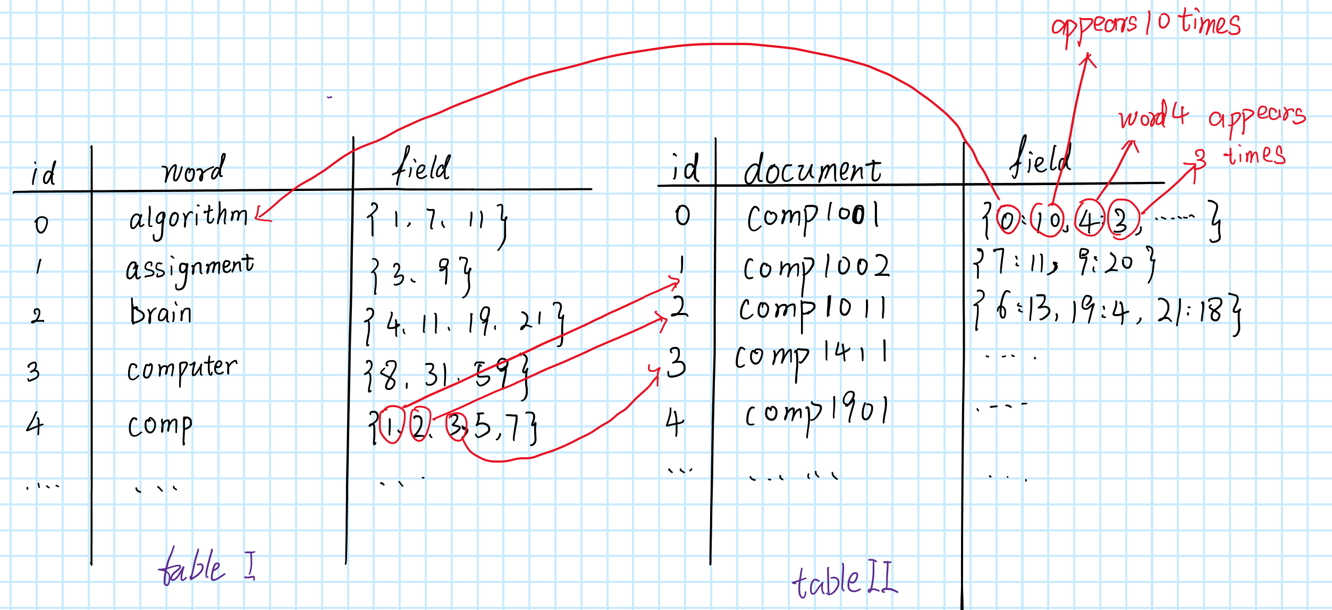
Algorithm

Slide 7
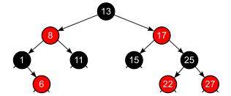
Algorithm
Use red-black tree to translate word to word ID

Slide 8
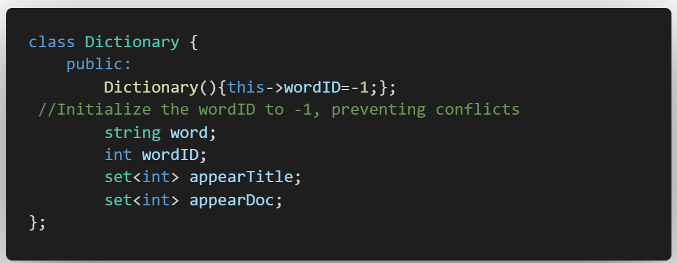
Data Structure
Two headers, contain two classes
Class Dictionary: contain word string, word ID, appeared document ID in title/content

Slide 9
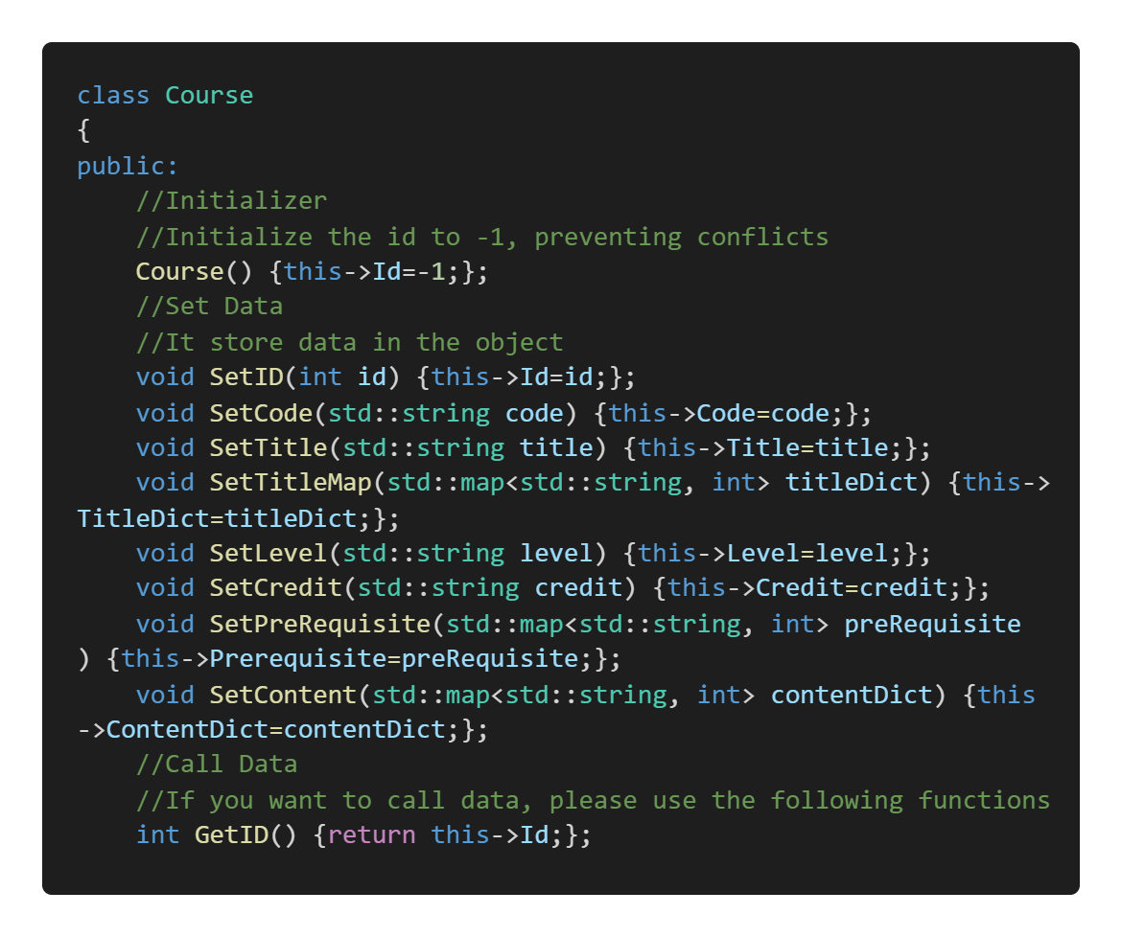
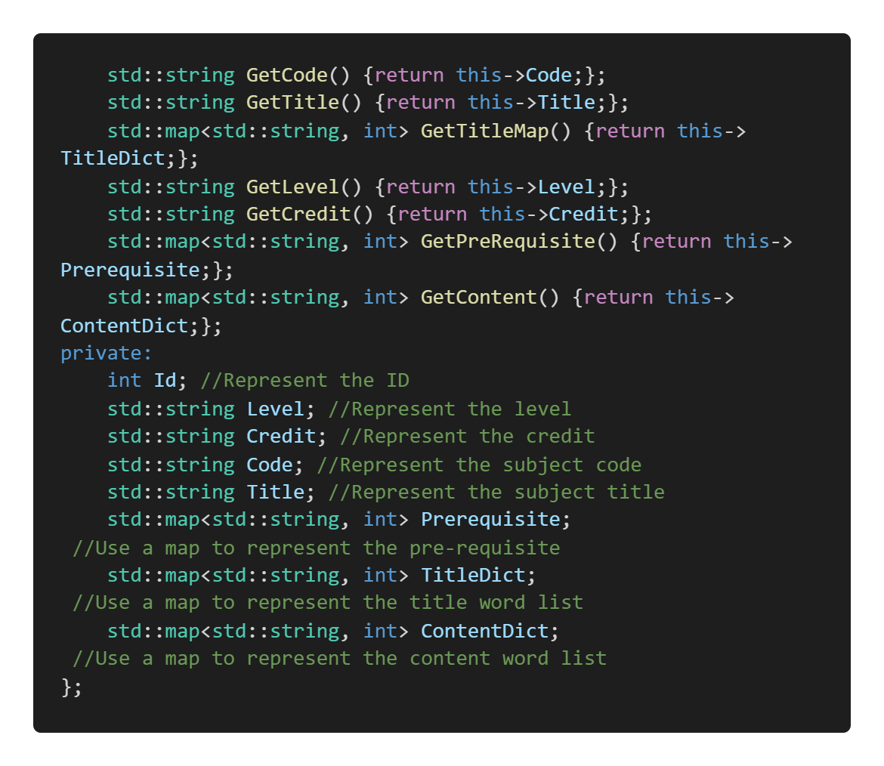
Data Structure
Class Course: contain course code, name, title, pre-requisite, credit, and word id appeared times

Slide 10
Implementation
Data Pre-process
Data Structure Design
User Input Process
Relative Index Calculation
Result Display

Slide 11
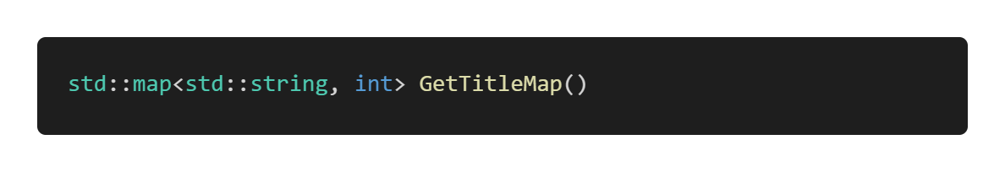
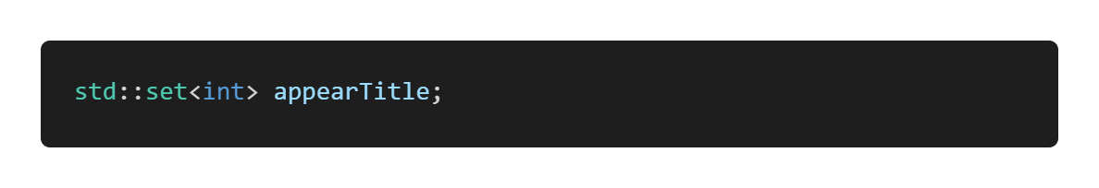
Implementation
We use Python to download and clean the data
C++ for main function process
Transform from PDF to TXT to JSON.
Implement

Slide 12
Thank you
COMP1011 Group 8

